Slide 1



project
Thread
03

Slide 2
FEASIBILITY STUDY &PROJECT PROPOSAL 1
INTRODUCTION:
Threads is a Social media application, owned by the American technology company Meta Platforms. The application works similarly to Twitter or (X), where users can post texts, photos, and videos; In addition to responding to others’ posts and liking them.
posts are now automatically translated based on the language they’re written in and the language setting of the person viewing it.
It allows for more privacy, such as not being able to see the last time you used the application.
PROBLEMS:

Slide 3
BACKGROUND:
Meta Platforms is a technology conglomerate that owns and develops some of the most popular social media platforms including Facebook, Instagram, WhatsApp and others . The current CEO of Meta is Mark Zuckerberg Founded on July 4, 2004 and based in Menlo Park, California.
The problem of few characters: The program allows users to use 500 characters.
The problem of the duration of the short clip: The program allows publishing videos that are up to 5 minutes long.
Story problem: The program allows you to specify the people you want to see your story.
PROPOSED SOLUTION :

Slide 4
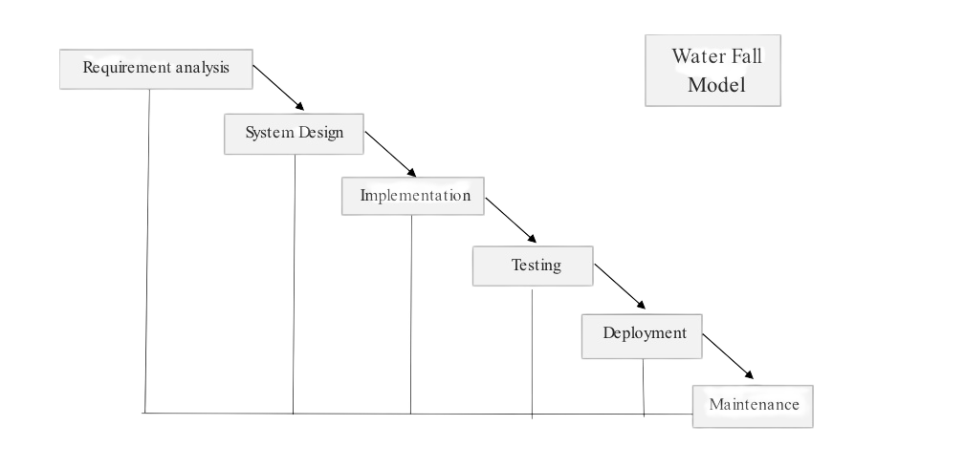
WORK PLAN:
Waterfall Model : A plan-driven approach to software engineering is based around separate development stages with the outputs to be produced at each of these stages planned in advance.
-Requirement Gathering and analysis
-System Design
-Implementation
-Integration and Testing
-Deployment of system
-Maintenance

Slide 5
We have two actors , they are :
- Admin - Users
The Administrator should be able to:
- Login.
- Delete user account.
- Add ,view , modify or delete section.
- Logout
The users should be able to:
- Login.
- Modify personal information.
- Add or delete comments.
- Logout.
WRITE THE FR PERFECTLY(8)?
2-PROJECT REQUIREMENTS :

Slide 6
2-PROJECT REQUIREMENTS :
WRITE THE NFR PERFECTLY(4) ?
Usability: The clarity of the website so that users can use it easily.
Security: Protect the site from hack so every user should have a
account with a minimum password with 6 characters.
Accessibility: The system shall be accessible by several users at the same time.
Portability: The possibility of running the site on all Internet browsers.

Slide 7
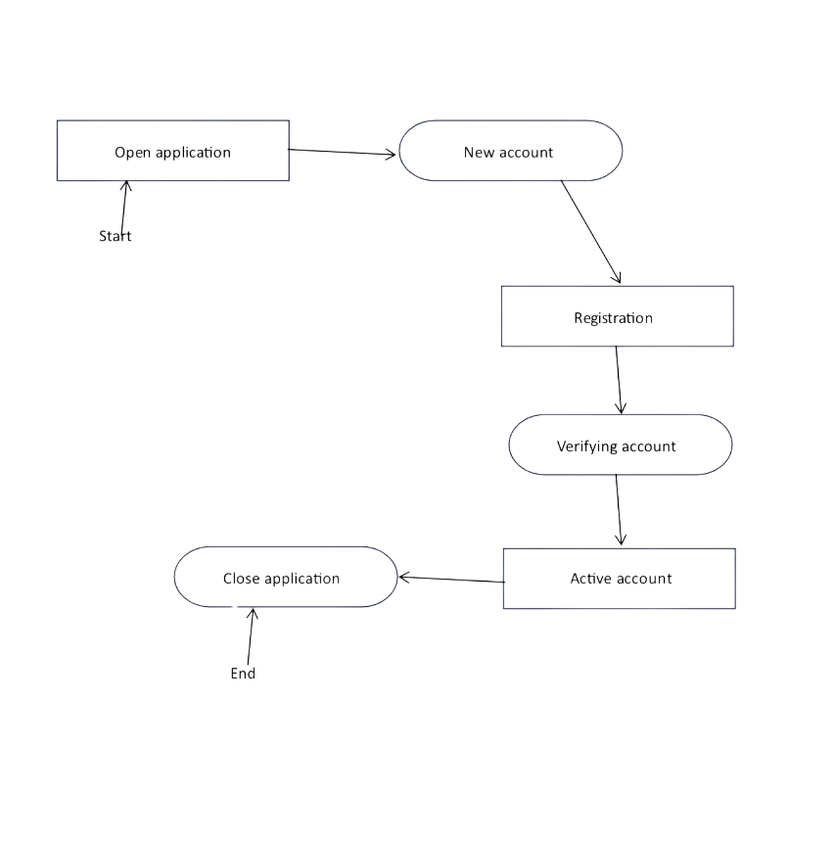
3- ACTIVITY DIAGRAM:

Slide 8
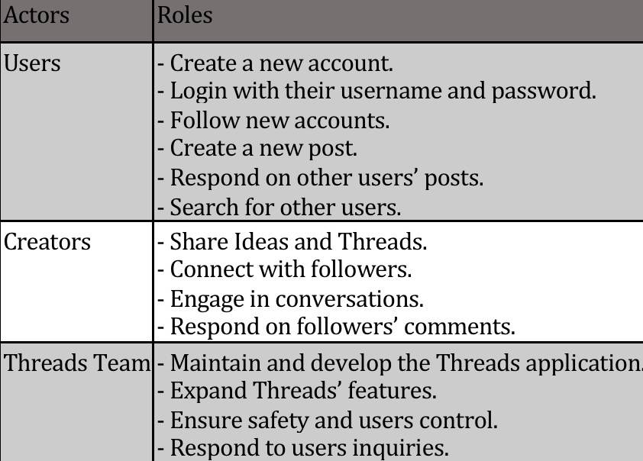
4 -PROJECT USE CASE MODELLING :
Actors Table:

Slide 9
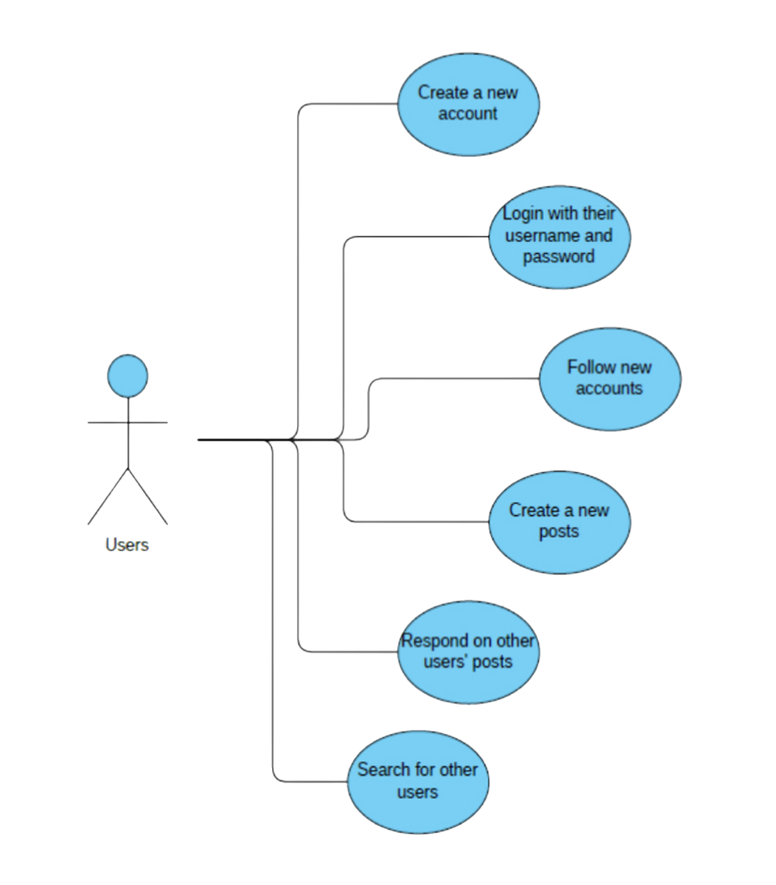
1. Users

Slide 10
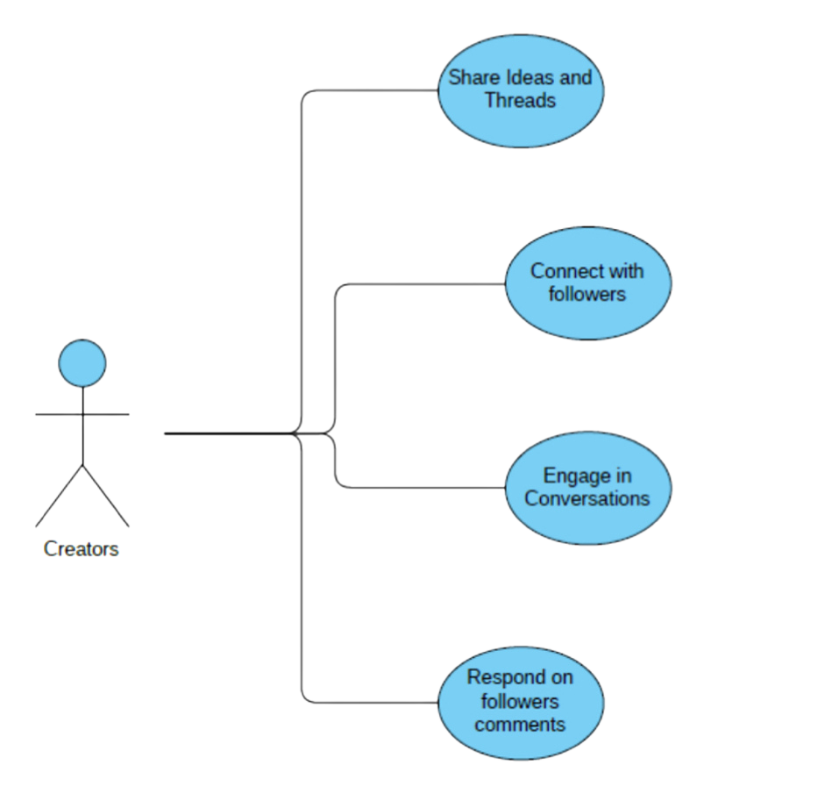
2. Creators

Slide 11
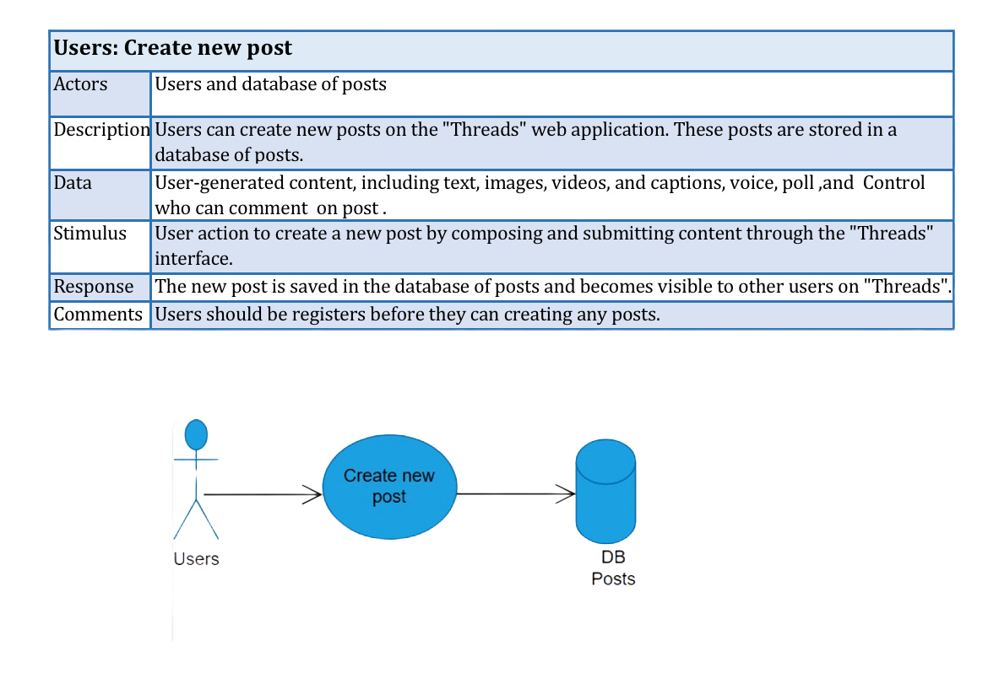

Slide 12
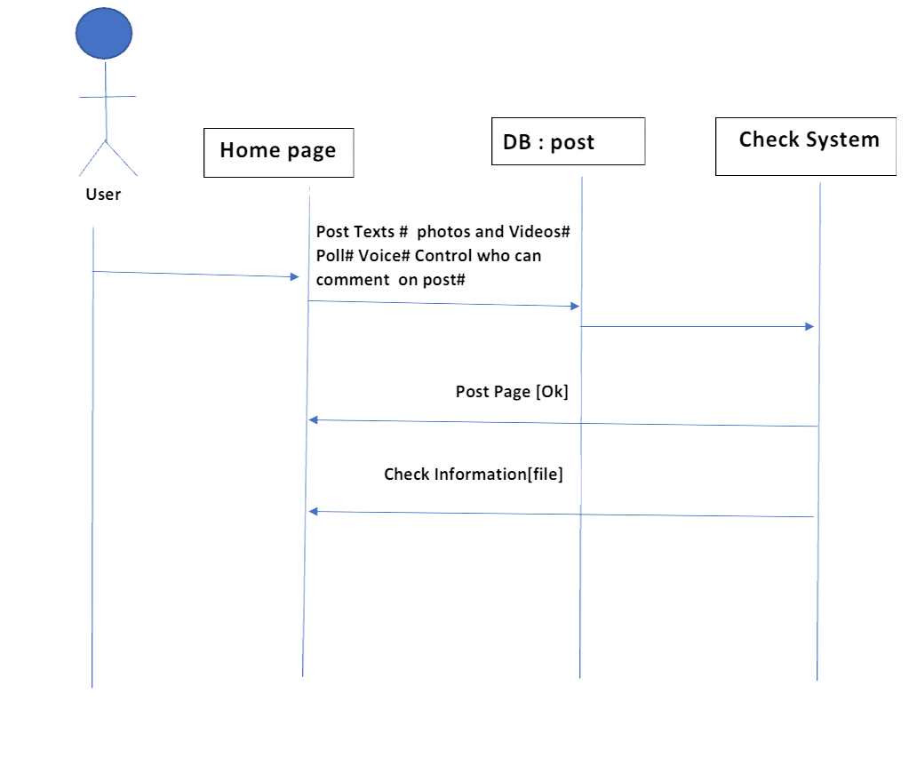
CreatingSequence DIAGRAM :

Slide 13
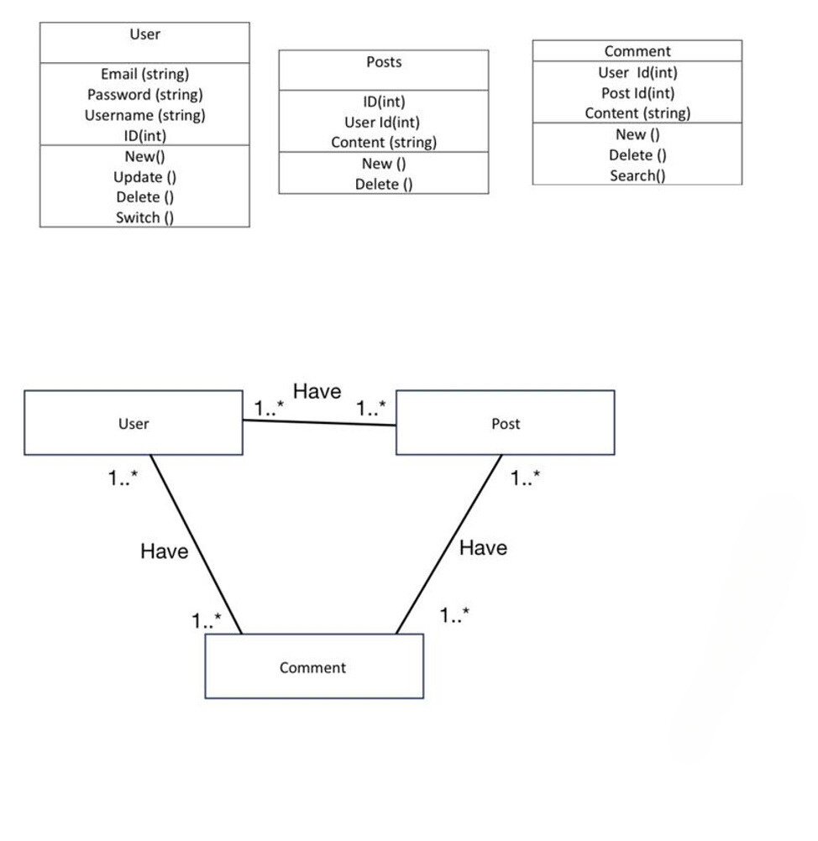
6 .Creating a Class Diagram :

